Slide 1
Data Structures
>>> data = [ ]
MODULE 4
Strings in depth, lists, tuples, sets and dictionaries
Noorjahan · ASAP / AIML Batch 5
Notes:
This is the most important module in the course. Almost every real program, and every ML workflow, is about storing and moving collections of data. Expect to spend extra time here.

Slide 2
What we'll cover
TODAY
01
Strings in depth: indexing, slicing and methods
02
Lists: the everyday workhorse
03
Tuples and sets
04
Dictionaries: data with labels
05
Comprehensions, and choosing the right structure
Python Fundamentals · Module 4
02
Notes:
This module works best over two or three sessions: strings and lists (slides 3–11), tuples, sets and dictionaries (slides 12–17), then comprehensions and practice (slides 18–20).

Slide 3
Loops from Module 3
QUICK RECAP
if / elif / else choose which block runs
for goes through items one at a time
while repeats until a condition is False
Today: things worth looping over
# Quick check: what prints?
count = 0
for ch in "banana":
if ch == "a":
count += 1
print(count)
Python Fundamentals · Module 4
03
Notes:
Answer: 3. A string is already a collection of characters, which is why the for loop works. Today we meet four more collection types.

Slide 4

One name, many values
WHY DATA STRUCTURES
WITHOUT
WITH A LIST
mark1 = 78
mark2 = 92
mark3 = 65
# ...mark60?
marks = [78, 92, 65]
# any number of values
List
Tuple
Set
Dictionary
[1, 2, 3]
(1, 2, 3)
{1, 2, 3}
{"a": 1}
Python Fundamentals · Module 4
04
Notes:
Point out the brackets: square for lists, round for tuples, curly for sets and dictionaries. Students will confuse these at first; the bracket tells you the type.

Slide 5
Every character has a position
STRINGS · INDEXING
0
1
2
3
4
5
P
Y
T
H
O
N
-6
-5
-4
-3
-2
-1
s = "PYTHON"
s[0] → 'P'
s[3] → 'H'
s[-1] → 'N'
Python Fundamentals · Module 4
05
Notes:
Counting starts at 0, the same rule as range(). Negative indexes count from the end: -1 is always the last character. s[6] gives an IndexError because the last index is 5. The same rules work for lists.

Slide 6
Taking a piece with [start:stop]
STRINGS · SLICING
s = "Programming" | RESULT
s[0:4] | 'Prog'
s[:3] | 'Pro'
s[3:] | 'gramming'
s[-3:] | 'ing'
s[::2] | 'Pormig'
s[::-1] | 'gnimmargorP'
Stop is excluded
Just like range()
Leave one out
No start means "from the beginning"; no stop means "to the end"
Third number = step
-1 walks backwards and reverses
Python Fundamentals · Module 4
06
Notes:
Slicing never gives an IndexError: s[0:100] just returns the whole string. s[::-1] is the classic one-line palindrome check: word == word[::-1].

Slide 7
Useful string methods
STRINGS · METHODS
CODE | RESULT | USE IT TO
" hi ".strip() | 'hi' | Trim spaces from both ends
"kerala".upper() | 'KERALA' | Change case (also .lower())
"Hello".replace("l", "L") | 'HeLLo' | Swap one piece of text for another
"a,b,c".split(",") | ['a', 'b', 'c'] | Break text into a list
"-".join(["a", "b"]) | 'a-b' | Glue a list back into text
"banana".count("a") | 3 | Count how often something appears
"banana".find("n") | 2 | Find the first position (-1 if missing)
Strings can't be changed in place. Methods return a new string, so save it: name = name.upper()
Python Fundamentals · Module 4
07
Notes:
Demo the immutability trap: name = "asha"; name.upper(); print(name) still prints asha. split() and strip() are used constantly when cleaning text data, e.g. input().strip().lower() to tidy user input. Others worth mentioning: .startswith(), .endswith(), .isdigit(), .title().

Slide 8
Lists: ordered and changeable
LISTS
marks = [78, 92, 65]
mixed = ["Asha", 21, True]
empty = []
marks[0] # 78
marks[-1] # 65
len(marks) # 3
marks[0] = 80
print(marks) # [80, 92, 65]
Square brackets
Items separated by commas
Same indexing as strings
Starts at 0; -1 is the last item
Mutable
Unlike strings, you can change items in place
Python Fundamentals · Module 4
08
Notes:
Lists can hold mixed types, but in practice a list usually holds one kind of thing: all marks, all names. Contrast with strings: s[0] = "J" fails, but marks[0] = 80 works.

Slide 9
Adding, removing and sorting
LISTS · METHODS
STEP | FRUITS IS NOW | WHAT IT DOES
fruits = ["apple", "banana"] | ['apple', 'banana'] | Start
.append("mango") | ['apple', 'banana', 'mango'] | Add to the end
.insert(0, "kiwi") | ['kiwi', 'apple', 'banana', 'mango'] | Add at a position
.remove("banana") | ['kiwi', 'apple', 'mango'] | Remove by value
.pop() | ['kiwi', 'apple'] | Remove the last item and return it
.sort() | ['apple', 'kiwi'] | Sort in place (A to Z)
List methods change the list itself. No need to save the result.
Python Fundamentals · Module 4
09
Notes:
Each row runs on the result of the row above. A classic bug: fruits = fruits.sort() sets fruits to None, because sort() changes the list and returns nothing. Also show .pop(0) to remove the first item, .reverse(), and .sort(reverse=True).

Slide 10
Looping and built-in helpers
LISTS · WORKING WITH THEM
marks = [78, 92, 65, 88]
for i, m in enumerate(marks, 1):
print(f"Student {i}: {m}")
CODE | RESULT
len(marks) | 4
sum(marks) | 323
max(marks) | 92
min(marks) | 65
sorted(marks) | [65, 78, 88, 92]
92 in marks | True
Student 1: 78
Student 2: 92
...
enumerate() gives the position and the item together.
Python Fundamentals · Module 4
10
Notes:
Average = sum(marks) / len(marks) = 80.75. Contrast sorted(marks), which returns a new sorted list and leaves marks unchanged, with marks.sort(), which changes marks itself. The 1 in enumerate(marks, 1) starts the count at 1 instead of 0.

Slide 11
Slices, nested lists and a copy trap
LISTS · MORE
Slicing
Lists inside lists
The copy trap
n = [10, 20, 30, 40, 50]
n[1:3] # [20, 30]
n[-2:] # [40, 50]
n[::-1] # reversed
grid = [[1, 2, 3],
[4, 5, 6]]
grid[1][2] # 6
a = [1, 2]
b = a
b.append(3)
print(a) # [1, 2, 3]!
Same rules as string slicing
Row first, then column. Like a table.
b = a shares one list. Use b = a.copy() for a real copy.
Python Fundamentals · Module 4
11
Notes:
The grid is a preview of NumPy arrays and images: an image is just a grid of pixel values. The copy trap goes back to the "label on a value" picture from Module 2: a and b are two labels on the same list.

Slide 12
Tuples: lists that can't change
TUPLES
point = (10, 20)
point[0] # 10
x, y = point # unpacking
print(x, y) # 10 20
point[0] = 5 # TypeError
one = (5,) # comma needed
Round brackets
Indexing and slicing work just like lists
Immutable
Once made, items can't be added, removed or changed
Use for fixed groups
Coordinates, RGB colours, a date (2026, 11, 2)
Python Fundamentals · Module 4
12
Notes:
Students already used tuples without knowing it: a, b = b, a in Module 2 is tuple packing and unpacking. (5) without the comma is just the number 5 in brackets. In ML, an array's shape is a tuple, e.g. (28, 28) for an image; students will see that often. Functions returning multiple values (Module 5) also return tuples.

Slide 13
Sets: unique values only
SETS
nums = {3, 1, 3, 2, 1}
print(nums) # {1, 2, 3}
tags = ["ml", "ai", "ml"]
set(tags) # {'ml', 'ai'}
nums.add(4)
nums.remove(1)
print(nums) # {2, 3, 4}
No duplicates
Repeats are dropped automatically. Great for de-duplicating a list.
No order
No index, so nums[0] gives a TypeError
Fast "in" checks
Ideal for "have I seen this before?"
Python Fundamentals · Module 4
13
Notes:
The order a set prints in may differ from the slide; sets don't promise any order. Gotcha: {} makes an empty dictionary, not a set. Use set() for an empty set. To count unique values: len(set(tags)).

Slide 14
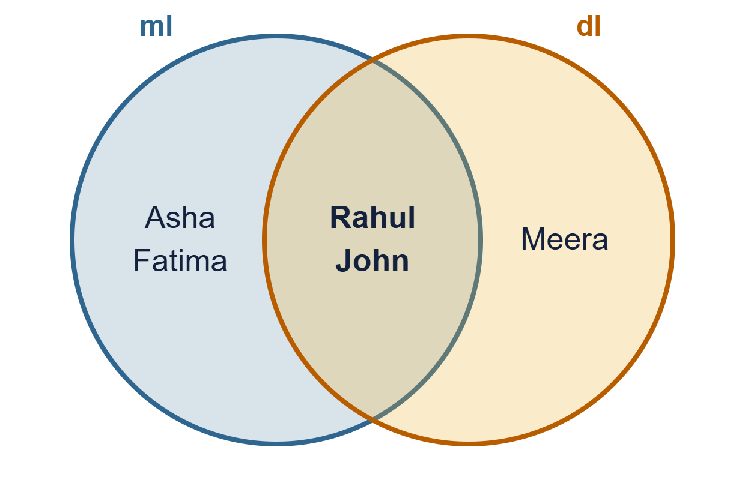
Comparing two groups
SETS · OPERATIONS
CODE | MEANS | RESULT
ml | dl | In either class | All 5 students
ml & dl | In both | Rahul, John
ml - dl | Only in ML | Asha, Fatima
ml ^ dl | In one, not both | Asha, Fatima, Meera
Python Fundamentals · Module 4
14
Notes:
Set up first: ml = {"Asha", "Fatima", "Rahul", "John"} and dl = {"Rahul", "John", "Meera"}. The word versions also work: ml.union(dl), ml.intersection(dl), ml.difference(dl). These are the same as union and intersection in school maths.

Slide 15
Dictionaries: values with labels
DICTIONARIES
student = {
"name": "Asha",
"age": 21,
"city": "Kochi"
}
student["name"] # 'Asha'
student["age"] = 22 # update
student["course"] = "ML" # add new
key : value pairs
Look things up by name, not by position
Keys are unique
Assigning to an existing key replaces its value
Missing key?
student["phone"] gives a KeyError. student.get("phone", "N/A") returns 'N/A' instead.
Python Fundamentals · Module 4
15
Notes:
Analogy: a real dictionary, where you look up a word (key) to get its meaning (value). Keys are usually strings, but numbers and tuples work too; lists can't be keys. Dictionaries look a lot like JSON, which students will meet when working with APIs.

Slide 16
Looping and counting with dictionaries
DICTIONARIES · LOOPS
Loop over pairs
The counting pattern
for key, value in student.items():
print(f"{key}: {value}")
words = "to be or not to be".split()
counts = {}
for w in words:
counts[w] = counts.get(w, 0) + 1
name: Asha
age: 22
...
{'to': 2, 'be': 2,
'or': 1, 'not': 1}
Also: .keys(), .values(), and "name" in student
Python Fundamentals · Module 4
16
Notes:
The counting pattern is worth memorising: .get(w, 0) returns 0 the first time a word is seen, then adds 1. It's the basis of word-frequency analysis in NLP. To remove a pair use student.pop("city") or del student["city"].

Slide 17
A student marks analyzer
PUTTING IT TOGETHER
students = [
{"name": "Asha", "marks": 88},
{"name": "Rahul", "marks": 72},
{"name": "Meera", "marks": 95},
]
total = 0
for s in students:
print(f"{s['name']}: {s['marks']}")
total += s["marks"]
print(f"Average: {total / len(students):.1f}")
OUTPUT
Asha: 88
Rahul: 72
Meera: 95
Average: 85.0
A list of dictionaries is a table: each dict is one row.
Python Fundamentals · Module 4
17
Notes:
This structure is exactly what Pandas turns into a DataFrame: pd.DataFrame(students) gives a two-column table. Inside the f-string, single quotes are used for 's['name']' because the f-string itself uses double quotes. Extension: also print who scored highest.

Slide 18
Building a list in one line
COMPREHENSIONS
WITH A LOOP
WITH A COMPREHENSION
squares = []
for n in range(1, 6):
squares.append(n ** 2)
squares = [n ** 2 for n in range(1, 6)]
# [1, 4, 9, 16, 25]
MORE EXAMPLES | RESULT
[n for n in range(10) if n % 2 == 0] | [0, 2, 4, 6, 8]
[name.upper() for name in ["asha", "rahul"]] | ['ASHA', 'RAHUL']
{n: n ** 2 for n in range(1, 4)} | {1: 1, 2: 4, 3: 9}
Python Fundamentals · Module 4
18
Notes:
Read it as "n squared, for each n in range 1 to 5". The pattern is [what_to_keep for item in collection if condition]. The last row is a dictionary comprehension. Keep comprehensions short; if one needs a second line, a normal loop is clearer.

Slide 19
Which one should I use?
SUMMARY
TYPE | LOOKS LIKE | ORDERED | CHANGEABLE | DUPLICATES | BEST FOR
List | [1, 2] | Yes | Yes | Yes | A growing collection
Tuple | (1, 2) | Yes | No | Yes | Fixed groups of values
Set | {1, 2} | No | Yes | No | Unique values, "is it in?"
Dict | {"a": 1} | Yes | Yes | Keys: no | Looking up by label
Ask: do I need order? Will it change? Do values need labels? Must they be unique?
Python Fundamentals · Module 4
19
Notes:
Dictionaries keep the order keys were added in (Python 3.7 and later). Quick quiz: a student's marks in 5 subjects? List, or a dict with subject names. GPS coordinates? Tuple. Email addresses with no repeats? Set. A product's name, price and stock? Dict.

Slide 20
Your turn
PRACTICE
Check whether a word is a palindrome using slicing
From a list of marks, print the average, highest and lowest
Remove the duplicates from a list of names
Count how often each word appears in a sentence
Phone book: a dictionary you can add to, look up and delete from
NEXT UP
Module 5: Functions
Writing reusable code with def, parameters and return
Python Fundamentals · Module 4
20
Notes:
Give 30 minutes. (1) word.lower() == word.lower()[::-1]; try "Malayalam". (2) sum(marks) / len(marks), max(), min(). (3) list(set(names)); note that the order may change. (4) The .get(w, 0) + 1 pattern from slide 16. (5) Use a while loop with a menu: add, search, delete, quit, which combines Modules 3 and 4.

